Slide 1
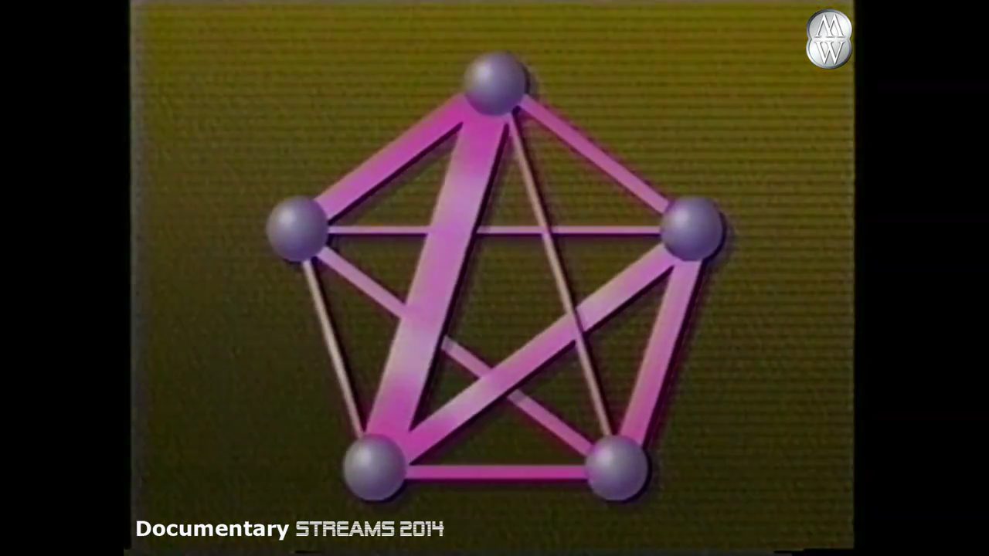
Evolving Perceptrons
Sergi Valverde
Evolutionary Algorithms (2015)
Notes:
Movies and popular science culture have assumed that the highest levels of technology will be reached when technology is capable of imitating nature in a way that we cannot longer distinct between artificial and natural beings.

Slide 2
Continuous Genetic Algorithms
Genetic algorithms are a type of optimisation algorithm, meaning they are used to find the maximum or minimum of a function.
Notes:
Genetic algorithms are a type of optimisation algorithm, meaning they are used to find the maximum or minimum of a function.
http://funkylindsay.com/blog/2012/10/13/pinterest-drives-my-instruction-math-games/
Algorisme Genetic és el joc del “qui és qui”. La funció fitness és el nostre adversari. Cal fer-li preguntes i anar avançant fins que descubrim qui és l’òptim. Al principi, tenim la maxima incertesa. Hi ha un factor d’atzar en les nostres questions. Pero de mica en mica, les possibilitats es van restringint fins que es evident la solució.
Podem quantificar el patró de reducció de la incertesa amb la “teoria dels esquemes” (teoria).
This is also similar to the game “21 questions” by Carl Sagan.

Slide 3
Materials
testfunction.m
plotc_testfunction.m
continuous_ga.m

Slide 4
Genetic Algorithms
1. A Fitness function for Optimisation
2. A Population of “Chromosomes”
3. Selection for reproduction
4. Crossover to produce next generation
5. Random mutation
Notes:
An Introduction to Genetic Algorithms
Jenna Carr (May 30, 2014)

Slide 5
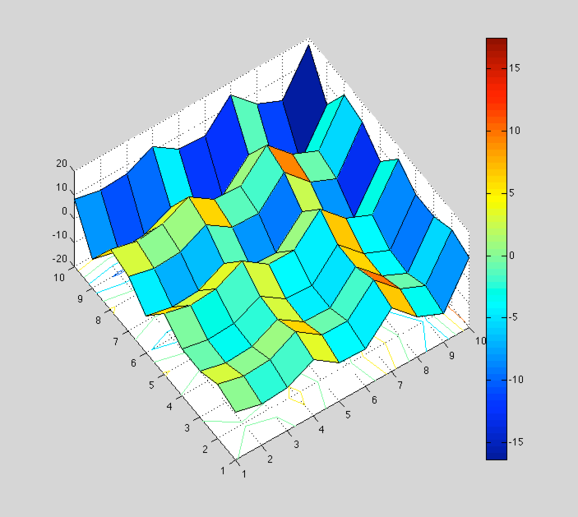
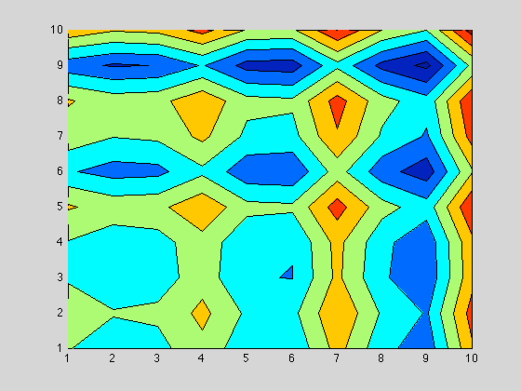
1. A Fitness function for Minimisation
Suppose that we are searching for the point of lowest elevation on a (theoretical) landscape where longitude ranges from 0 to 10, and latitude ranges from 0 to 10 and the elevation is given by the function
Fitness = f(x,y) = x sin (4 x ) + 1.1 y sin (2 y )
testfunction.m
Notes:
The fitness function is the function that the algorithm is trying to optimise. The word ‘fitness’ is taken from evolutionary theory. It is used here because the fitness function tests and quantifies how ‘fit’ each potential solution is. The fitness function is one of the most pivotal parts of the algorithm.

Slide 6
1. A Fitness function for Minimisation
Before execution, we have to set all the parameters of the algorithm (see below).
The continuous genetic algorithm minimises the fitness function designated by the variable ff.
Because f(x,y) is a function of 2 variables, Npar = 2.

Slide 7

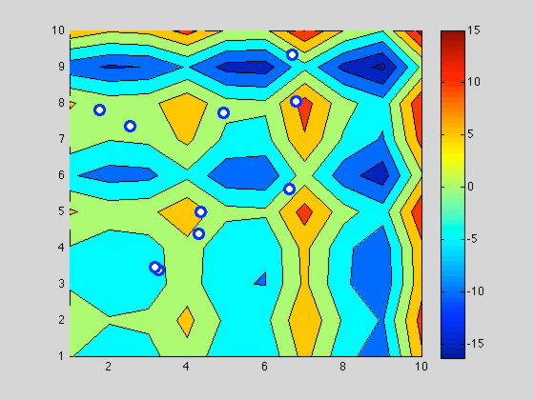
2. A Population of “Chromosomes”
A
>> A =[6.6886 9.341]
>> testfunction(A)
ans =
4.9663
B
>> B=[6.7911 8.0277]
c
>> testfunction(B)
ans =
3.0759
A candidate solution is encoded as an array of parameter values
If the problem has Npar =2 dimensions, then each chromosome is an Npar-element array.
Different types: bit strings, permutations, real numbers, matrices, and many others.
Notes:
The term chromosome refers to a numerical value or values that represent a candidate solution to the problem that the genetic algorithm is trying to solve. Each candidate solution is encoded as an array of parameter values, a process that is also found in other optimisation algorithm.
If a problem has N_{par} dimensions, then typically each chromosome is encoded as an N_par element array.

Slide 8


Sampling 2-D Space
How do we sample
the search space ?
Notes:
Let the function take the following arguments:
• the objective function; • the length n of the vector ⃗x; • a vector of length n containing the lower bounds of the search domain; • a vector of length n containing the upper bounds of the search domain; • the maximum number of fitness function evaluations.
Let the function produce as outputs: • the best individual found by the algorithm; • the fitness of the best individual.
Run the algorithm on the Ackley function for 100 iterations with n = 2, xi ∈ [−5, 5], and c1 = 20, c2 = 0.2, c3 = 2π. Plot the fitness versus the number of iterations.
Note: we are now optimizing a minimization problem.

Slide 9



Sampling 2-D Space
Search Space
Notes:
Let the function take the following arguments:
• the objective function; • the length n of the vector ⃗x; • a vector of length n containing the lower bounds of the search domain; • a vector of length n containing the upper bounds of the search domain; • the maximum number of fitness function evaluations.
Let the function produce as outputs: • the best individual found by the algorithm; • the fitness of the best individual.
Run the algorithm on the Ackley function for 100 iterations with n = 2, xi ∈ [−5, 5], and c1 = 20, c2 = 0.2, c3 = 2π. Plot the fitness versus the number of iterations.
Note: we are now optimizing a minimization problem.

Slide 10
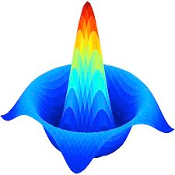


Sampling 2-D Unit Space
octave> rand(2,1)

Slide 11

Sampling 2-D Space
octave> rand(2,1)
octave> rand(2,1).* (ub-lb)
Notes:
Let the function take the following arguments:
• the objective function; • the length n of the vector ⃗x; • a vector of length n containing the lower bounds of the search domain; • a vector of length n containing the upper bounds of the search domain; • the maximum number of fitness function evaluations.
Let the function produce as outputs: • the best individual found by the algorithm; • the fitness of the best individual.
Run the algorithm on the Ackley function for 100 iterations with n = 2, xi ∈ [−5, 5], and c1 = 20, c2 = 0.2, c3 = 2π. Plot the fitness versus the number of iterations.
Note: we are now optimizing a minimization problem.

Slide 12
Sampling 2-D Space
octave> rand(2,1).* (ub-lb) + lb
octave> rand(2,1).* (ub-lb)
Notes:
Let the function take the following arguments:
• the objective function; • the length n of the vector ⃗x; • a vector of length n containing the lower bounds of the search domain; • a vector of length n containing the upper bounds of the search domain; • the maximum number of fitness function evaluations.
Let the function produce as outputs: • the best individual found by the algorithm; • the fitness of the best individual.
Run the algorithm on the Ackley function for 100 iterations with n = 2, xi ∈ [−5, 5], and c1 = 20, c2 = 0.2, c3 = 2π. Plot the fitness versus the number of iterations.
Note: we are now optimizing a minimization problem.

Slide 13
Sampling 2-D Space
octave> rand(2,1).* (ub-lb) + lb
Notes:
Let the function take the following arguments:
• the objective function; • the length n of the vector ⃗x; • a vector of length n containing the lower bounds of the search domain; • a vector of length n containing the upper bounds of the search domain; • the maximum number of fitness function evaluations.
Let the function produce as outputs: • the best individual found by the algorithm; • the fitness of the best individual.
Run the algorithm on the Ackley function for 100 iterations with n = 2, xi ∈ [−5, 5], and c1 = 20, c2 = 0.2, c3 = 2π. Plot the fitness versus the number of iterations.
Note: we are now optimizing a minimization problem.

Slide 14
2. A Population of “Chromosomes”
A Genetic Algorithm begins with a randomly chosen assortment of chromosomes, which serves as the first generation (initial population).
We define popsize = 12, the mutation rate to be 0.2 and the number of iterations to be 100.

Slide 15
2. A Population of “Chromosomes”
Then each chromosome in the population is evaluated by the fitness function to test how well it solves the problem at hand. The whole population is sorted according to the fitness function in ascendent order (minimization) or descendent order (maximization).

Slide 16
3. Selection for reproduction
The Selection Operator chooses some of the chromosomes for reproduction. The fitter a chromosome is, the more likely is to be selected. Chromosomes can be chosen more than once.
Instead of replacing the whole population, we keep the fitter half (selection =0.5) and generate the other half through selection and crossover.

Slide 17
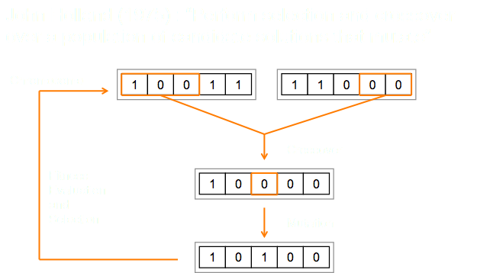
4. Crossover to produce next generation
The crossover operator resembles the biological crossing over and recombination of chromosomes in cell meisosis.
Parents are chosen at random.

Slide 18
4. Crossover to produce next generation
We use BLENDING (Haupt’s method) for non-binary chromosomes.
Ex: Chromosomes m & d (crossover point is x)
(B = 0.34 )
m = (xm, ym) = [ 7.54 , 3.17 ]
d = (xd, yd) = [ 2.76 , 1.86 ]
Offspring #1
(xnew1, ym) = (1-B) xm + B xd
= [(1-0.34) * 7.54 + 0.34 * 2.76, 3.17]
Offspring #2
(xnew2, yd) = B xm + (1-B) xd
= [0.34 * 7.54 + (1- 0.34)* 2.76, 1.86]
Notes:
Haupt, R. L., and Haupt, S. E. (1998) Practical Genetic Algorithms. New York: Wiley - Interscience.

Slide 19
5. Random mutation
Like the crossover operator, there are many different ways for adapting the mutation operator to a continuous genetic algorithm. Here, when a parameter in a chromosome mutates, its value is replaced with a random number between 0 and 10.
Notes:
Selection and crossover maintain the genetic information of fitter chromosomes but these chromosomes are only fitter relative to the current population. This can cause the algorithm to converge too quickly and lose ‘potentially useful genetic material’. In other words, the algorithm can get stuck at a local optimum before finding the global optimum . The mutation operator helps protect agains this problem by maintaining diversity in the population, but it can also make the algorithm converge more slowly.

Slide 20
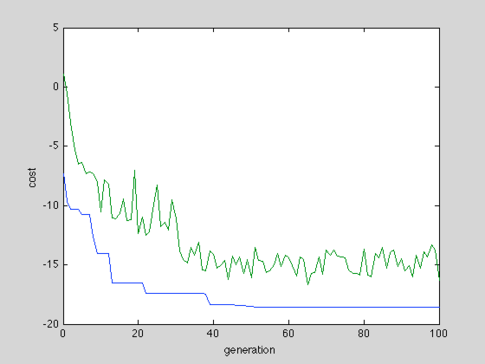
Execution
>> continuous_ga

Slide 21
SUMMARY
The performance of the GA depends highly on the method used to encode candidate solutions into chromosomes and “the particular criterion for success” or what the fitness function is actually measuring.
Other important details are the probability of crossover, the probability of mutation, the size of the population, and the number of iterations. These values can be adjusted after assessing the algorithm’s performance on a few trial runs.

Slide 22
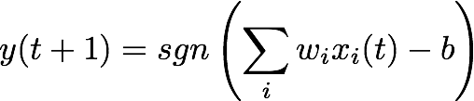
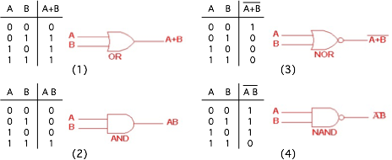
Evolving Perceptrons
Find Chromosome = [w1,w2, b] ???
b

